Slide 1


Software Test Automation Virtual Internship Program
Training Session
Powered By
Notes:
A very good morning one and all this is amrinder katakam.
welcome to faculty orientation session on naalaiya thiran project launched by anna university in association with department of information technology government of Tamil Nadu. naalaiya thiran is an experiential project-based learning initiative to empower the students with enhanced professional and technical skills.
This is a joint initiative of Anna University ICT Academy of Tamil Nadu nasscom and IBM and it is supported by the Tamil Nadu skill Development Corporation under the non mudhalvan scheme of government of Tamil Nadu.
As part of this program Anna University is offering a mandatory elective course called professional readiness for innovation employability and entrepreneurship with 3 credits as an extended 4 to 5 months hackathon to all the 6 semester students of bugst b tech IIT and bcp east of all non autonomous colleges autonomous colleges and university departments they will earn the credits in the 7th semester on completion of this course the credits earned will be considered in lieu of professional elective of the 7th semester this course has been approved by the board of studies faculty of ICE Anna University.

Slide 2


Agenda
Module 1: Fundamentals of Software Testing
Introduction to Software Testing
Software Development Life Cycle (SDLC)
Q&A

Slide 3

Software Development Life Cycle (SDLC)
The SDLC is a framework that describes the activities performed at each stage of a software development project.
SDLC process is used by the software industry to design, develop and test high quality software.
It aims to produce the quality software that meets customer expectations, teaches completion within time and budget

Slide 4
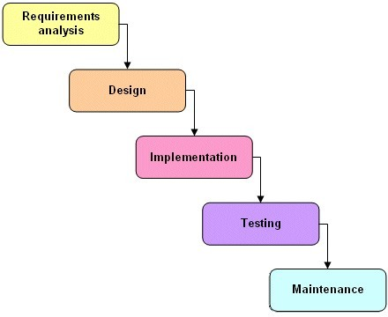
Software Development Life Cycle (SDLC)

Slide 5
Agenda
Module 2: Testing Techniques
Black Box Testing
White Box Testing(Glass Box Testing)
Unit/Module Testing and Integration Testing
Static Testing and Dynamic Testing
Q&A

Slide 6
Black Box Testing
Black box testing is Functional testing
In which test conditions are developed based on the program or system’s
functionality.
The tester requires information about the input data and observed output,
but does not know how the program or system works
The functionality is determined by observing the outputs to corresponding
inputs
In this the tester should only know the legal inputs and what the expected
output should be, but not how the program actually arrives at those
outputs.

Slide 7
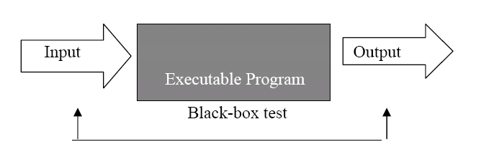
Black Box Testing

Slide 8
Black Box Testing
The Black box testing is used to find the errors listed below:
Interface errors, such as functions ,which are unable to send
or receive data to/from other S/W
Incorrect functions that lead to undesired outputs when
executed.
Missing functions and erroneous data structures
Erroneous databases, which lead to incorrect outputs when
the S/W uses the data present in these databases for
processing.

Slide 9
Black Box Testing
Some examples in this category include: decision tables, equivalence partitioning, range testing, boundary value testing, database integrity testing, cause effect graphing, orthogonal array testing, array and table testing, exception testing, limit testing, and random testing.

Slide 10
Black Box Testing
Advantages:
Tester requires no knowledge of implementation and programming language used.
Reveals any ambiguities and inconsistencies in the functional specifications.
Efficient when used on larger systems
A non technical person can also perform black box testing
Disadvantages:
Only a small number of possible inputs can be tested as testing every possible input
consumes a lot of time.
There can be unnecessary repetition of test inputs if the tester is not informed about
the test cases that the software developer has already tried.
Leaves many program paths untested
Cannot be directed towards specific segments of code; hence is more error prone.

Slide 11
White Box Testing
White-box testing, or structural testing, is one in which test conditions are
designed by examining paths of logic.
Also know as Clear Box testing, Transparent Testing and Glass box Testing
White-box testing is a testing technique in which paths of logic are tested to
determine how well they produce predictable results.
Test cases are defined by examining the logic paths of a system
For doing white box testing need the knowledge of the internal program
structure and logic, just as a mechanic knows the inner workings of an
automobile.

Slide 12
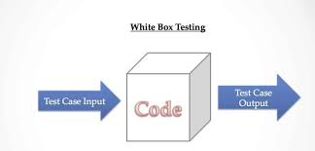
White Box Testing

Slide 13
White Box Testing
Specific examples in this category include:
Unit Testing
Integration Testing
Statement coverage
Branch coverage and condition coverage( branch/condition)
Data flow testing
Path testing.
Mutation Testing etc…

Slide 14
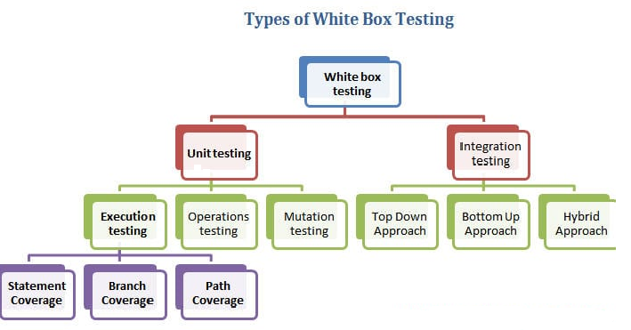
White Box Testing

Slide 15
White Box Testing
Advantage:
Advantage of white-box testing is that it is thorough and focuses on the produced code. Because there is knowledge of the internal structure or logic, errors or deliberate mischief on the part of a programmer have a higher probability of being detected.
Disadvantages:
Disadvantage of white-box testing is that it does not verify that the specifications are correct; that is, it focuses only on the internal logic and does not verify the logic to the specification.

Slide 16


Slide 17

https://smartinternz.com/katalon-virtual-internship-program-2023

